Slide 1
Senior Project Management System
Team: QIYE LI 542115507 YUKE CHEN 542115511
Advisor: Chartchai Doungsa-ard

Slide 2
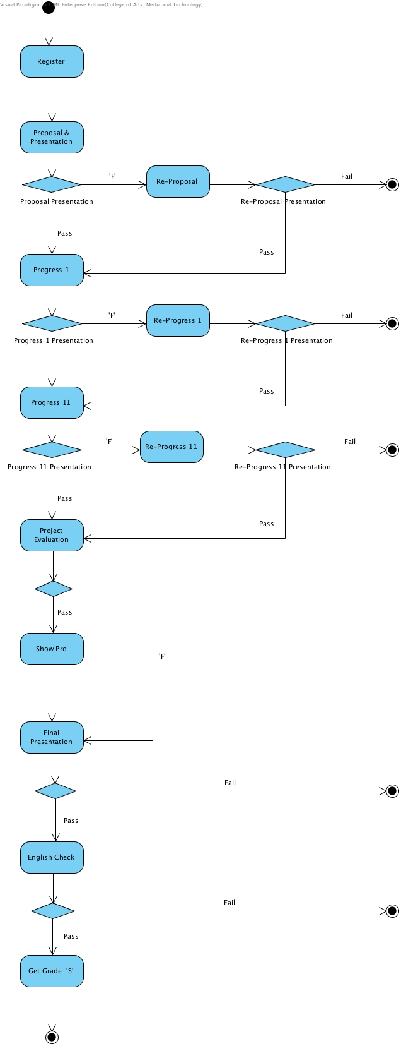

Slide 3
Senior Project Each Phase
Developing Phase
Preparing Phase
Grading Phase

Slide 4

Business Review
Problems
hard to apply for the Advisor (students)
Students want to know the team registration status.
hard to do team registration statistic (course coordinator)
hard to find document templates (students)
Communication Problem
Between Advisors and Students
Between Course Coordinate and Advisors
Preparing Phase

Slide 5
Business Review
Problems
hard to manage all the works (advisors)
Time planning
Version control
hard to know the changes (students)
Schedules changes
Developing Phase

Slide 6
Business Review
Problems
hard to assigns venue for presentations (course coordinator)
hard to statistic the results for presentations (course coordinator)
Grades for every team work
Status of every team
hard to submit the grade results (advisors)
Grading Phase

Slide 7



Similar Application Review
Group SMS
Google Calendar
Tecent QQ

Slide 8




Technology Review

Slide 9
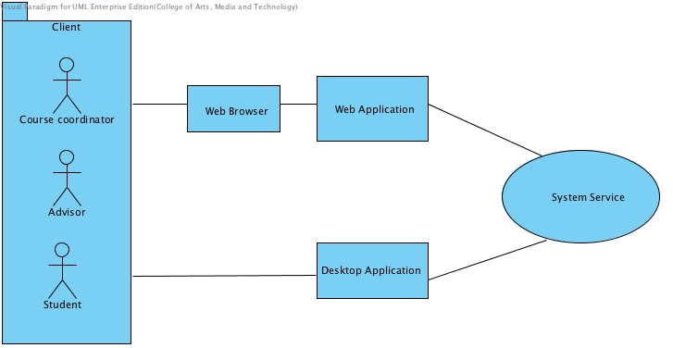
Architecture of Product

Slide 10

Proposal
Target User:
Course Coordinator
Adviser
Student
WORK
Easily and Efficiently

Slide 11

Features
Manage the senior project schedule
Inform messages by group.
Generate presentation detail.
Import and export relevant documents.
5. View grading result.
Course Coordinator
Adviser
Student
Edit profile information.
Manage appointments.
Take teams.
Manage the schedule for own teams.
View own teams statuses.
Register senior project course.
View real-time advisor’s statuses.
Search, view and message advisor.
Manage own schedule events.
View team status.
Scan previous senior project resource.

Slide 12

Features
Manage the senior project schedule
Inform messages by group.
Generate presentation detail.
Import and export relevant documents.
5. View grading result.
Course Coordinator

Slide 13

Features
Edit profile information.
Manage appointments.
Take teams.
Manage the schedule for own teams.
View own teams statuses.
Adviser

Slide 14

Features
Register senior project course.
View real-time advisor’s statuses.
Search, view and message advisor.
Manage own schedule events.
View team status.
Scan previous senior project resource.
Student

Slide 15
Architecture of Product

Slide 16

Limits
Version Control
Mobile Operating System

Slide 17
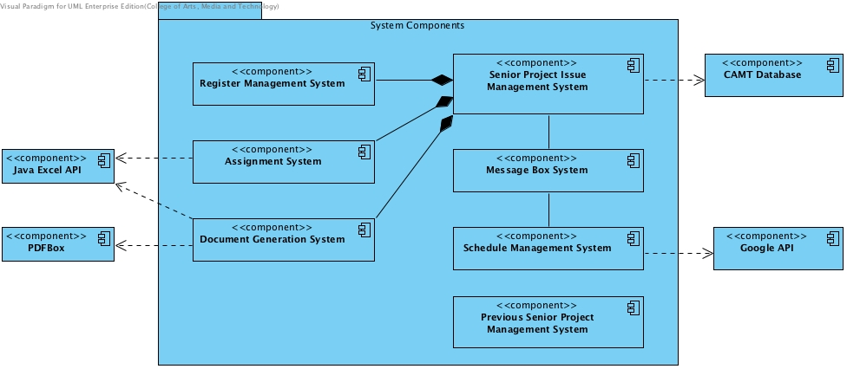
Components of Software

Slide 18
1. Senior Project Issue Management System

Slide 19
2. Message Box System

Slide 20
3. Schedule Management System

Slide 21
4. Previous Senior Project Management System

Slide 22
Schedule and Milestones
No. | Phase Name | Time | Content | Inclusive Features
1 | Topic Announcement | 32 days
2 | Proposal | 18 days | Proposal | All
3 | Progress Report Ⅰ | 62 days | 1.1 Register Management System 1.3 Document Generation System | 8 11 12 4 5
4 | Progress Report Ⅱ | 62 days | 1.2 Assignment System 3. Schedule Management System 1. Senior Project Issue Management System | 5 1 7 9 13 14 2 3 6 10 13 15
5 | Show Pro | 38 days | 4. Previous Senior project Management System 2. Message Box System | 16 2 8 7 9 13
6 | Final Project Presentation | 26 days | All functions of product | All

Slide 23
Next >>>>
No. | Phase Name | Time | Content | Inclusive Features
1 | Topic Announcement | 32 days
2 | Proposal | 18 days | Proposal | All
3 | Progress Report Ⅰ | 62 days | 1.1 Register Management System 1.3 Document Generation System | 8 11 12 4 5
4 | Progress Report Ⅱ | 62 days | 1.2 Assignment System 3. Schedule Management System 1. Senior Project Issue Management System | 5 1 7 9 13 14 2 3 6 10 13 15
5 | Show Pro | 38 days | 4. Previous Senior project Management System 2. Message Box System | 16 2 8 7 9 13
6 | Final Project Presentation | 26 days | All functions of product | All

Slide 24
Q & A

